Slide 1
Introduction to Test Taking and Behaviour
Dr Oliver Clark

Slide 2
Learning Outcomes
Understand what is meant by measurement and tests
Understand the relationship between behaviour, data, and phenomena

Slide 3

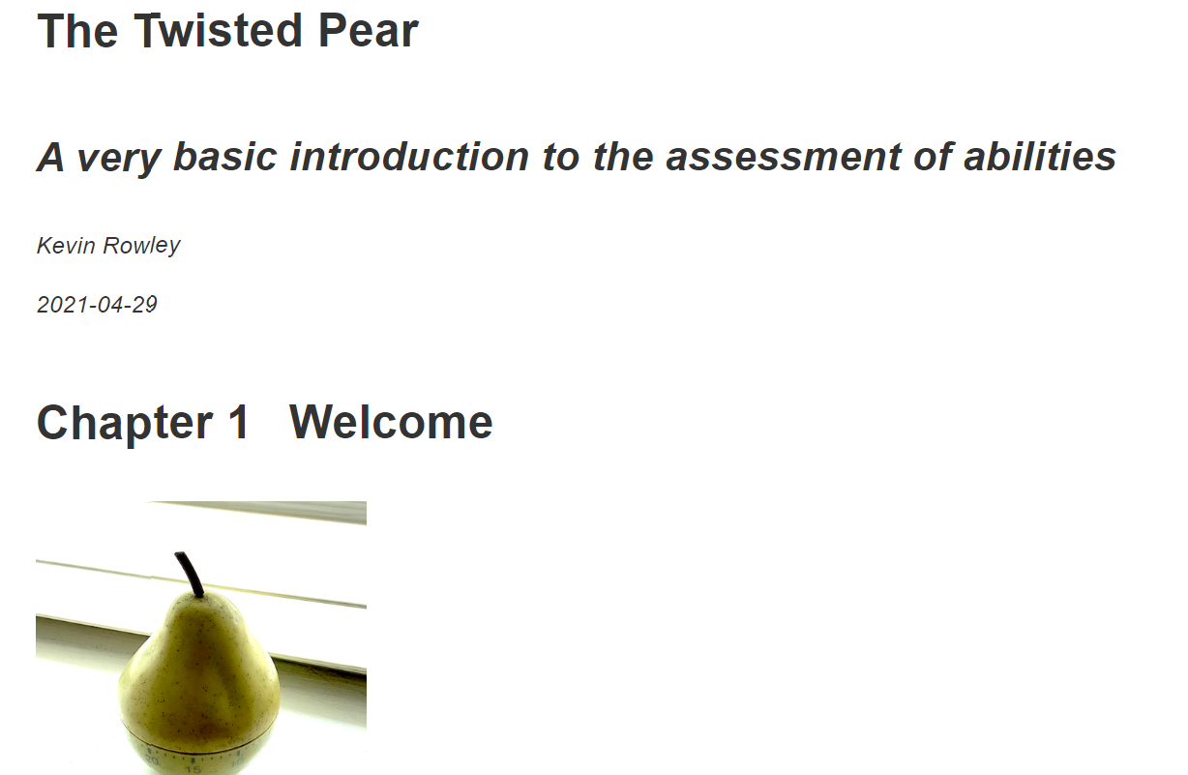
Reading
Up to Chapter 2.2
Chapter 1
The Twisted Pear

Slide 4
Structure
What is measurement?
What are tests?
When are they used?

Slide 5
What is Measurement?
If a thing exists, it exists in some amount....
–E. L. Thorndike (1914)

Slide 6
What is Measurement?
If a thing exists, it exists in some amount….; and if it exists in some amount, it can be measured.”
–E. L. Thorndike (1914)

Slide 7
Measurement
Is a statement indicating the quantity of ‘a thing’
Expressed numerically
Numerical statements have:
Identity
Order
Magnitude

Slide 8
Measurement
Identity
is something the same or different?
Are mutually exclusive
No indication of quantity
Order
Relative differences between entities
No information about distance between entities
Quantity
Exact statement about quantity
Furr (Chapter 2)

Slide 9
What are Psychological Tests?
“A systematic procedure for comparing the behaviour of one or more people”
Cronbach (1960, p 21)

Slide 10
What are Psychological Tests
Implication that psychological attributes:
exist
can be measured
can vary between individuals and groups

Slide 11
What are Psychological Tests?
Example Behaviour:
Ability
Ability
To Solve
To Make
Numerical
Spatial
Mechanical
New
Verbal
Puzzles
Friends

Slide 12
What are Psychological Tests?
Example Behaviour:
Propensity
Ability
To Make
New
Friends
Self reported number of friends and recency of acquaintance?
Self reported response to items that predict making new friends

Slide 13
What are Psychological Tests?
Example Behaviour:
Ability
To Make
New
Friends
Ask about number of friends and date of acquaintance at time 1
Change in
Ask about number of friends and date of acquaintance at time 2

Slide 14
Why Study Behaviour?
Observe Behaviour
Develop Theories
Generate hypotheses
Make predictions
Collect data
Apply to the real world

Slide 15
Why Study Behaviour?
Theories
‘…set[s] of axioms or assumptions that explain, predict, and control phenomena’ (Fried; 2020)
Axioms or Assumptions:
“A statement that is taken to be true”
Phenomena
Robust features of the world

Slide 16
Why Study Behaviour?
Hypotheses
Predictions about phenomena that are drawn from a theory that if confirmed corroborate the theory

Slide 17
Why Study Behaviour?
Data
“…public records produced by measurement and experiment that serve as evidence for the existence or features of phenomena.” Woodward (2011)
Data = Phenomena ± Error

Slide 18
Why Study Behaviour?
To generate theories that predict, explain, or control behaviour.
In the workshop we will discuss some of the scenarios in which behaviour might be measured
We will also discuss the relationship between behaviours and attributes

Slide 19
References
Cronbach, L. J. (1960). Essentials of psychological testing (2e ed. rev.).
Fried, E. I. (2020). Lack of theory building and testing impedes progress in the factor and network literature. Psychological Inquiry, 31(4), 271-288.
Thorndike, E. L. (1914, September). Units and scales for measuring educational products. In Proceedings of a Conference on Educational Measurements (pp. 128-141).

